Slide 1
OCEAN ENERGY MARKET DEVELOPMENT SUMMIT
TECHNOLOGY DEVELOPERS SHOWCASE
05 December 2019

Slide 2
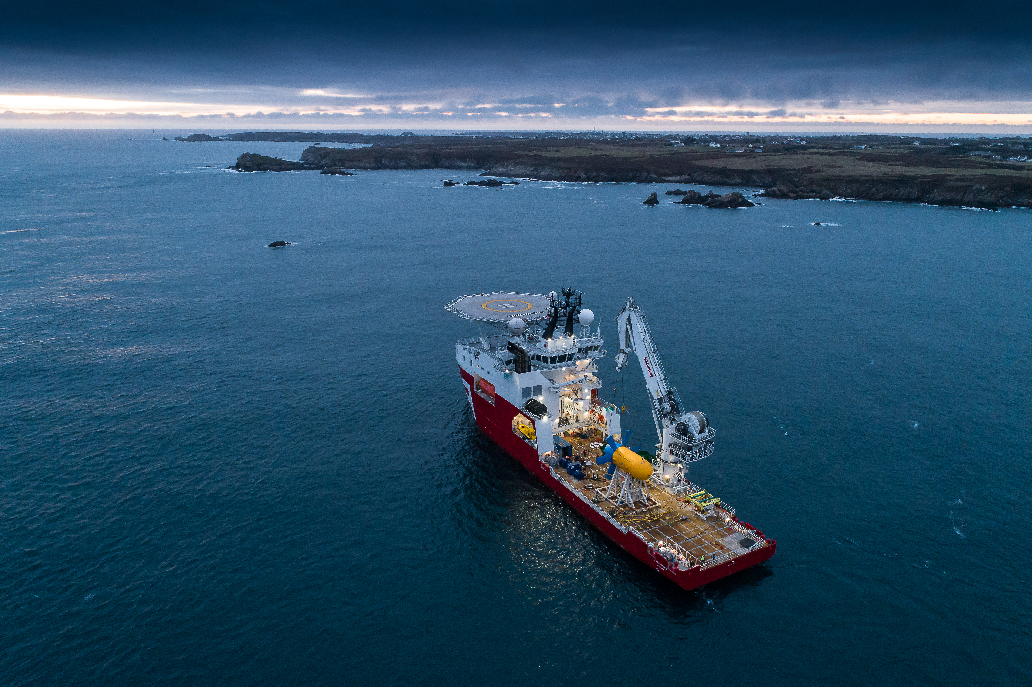

Slide 3
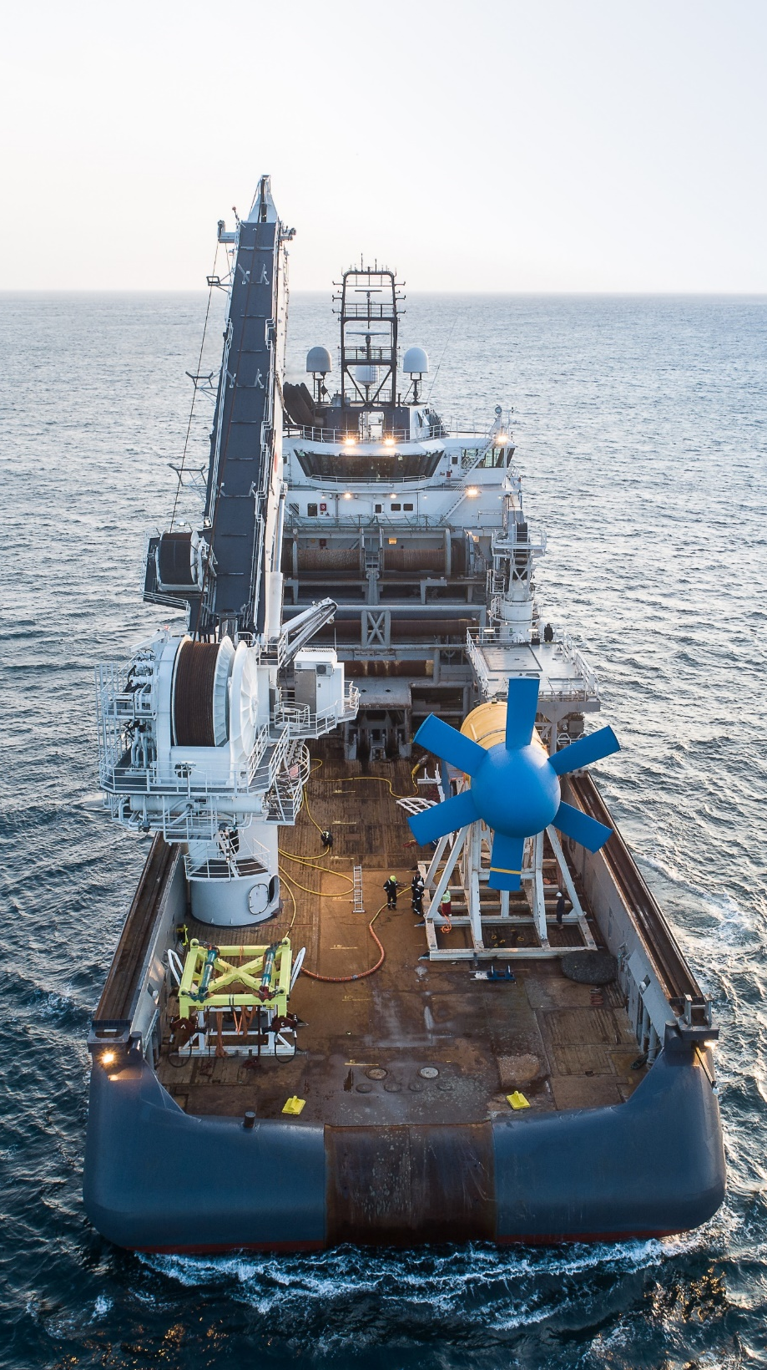
WHO ARE WE?
A company dedicated to the development and deployment of tidal energy converters
A team
based in Quimper France
25
engineers
Founded in
2008
Business model: EPCI
Turnover 2018
€1M
(engineering, procurement, construction and installation)
2
12
tried-and-tested turbines
offshore operations
8
Patents
SABELLA
Notes:
Public funding for R&D projects (€7 million grants and conditional debt) and private funding for company development (€4.3 million fundraising in 2014 and €8 million fundraising in 2016);

Slide 4
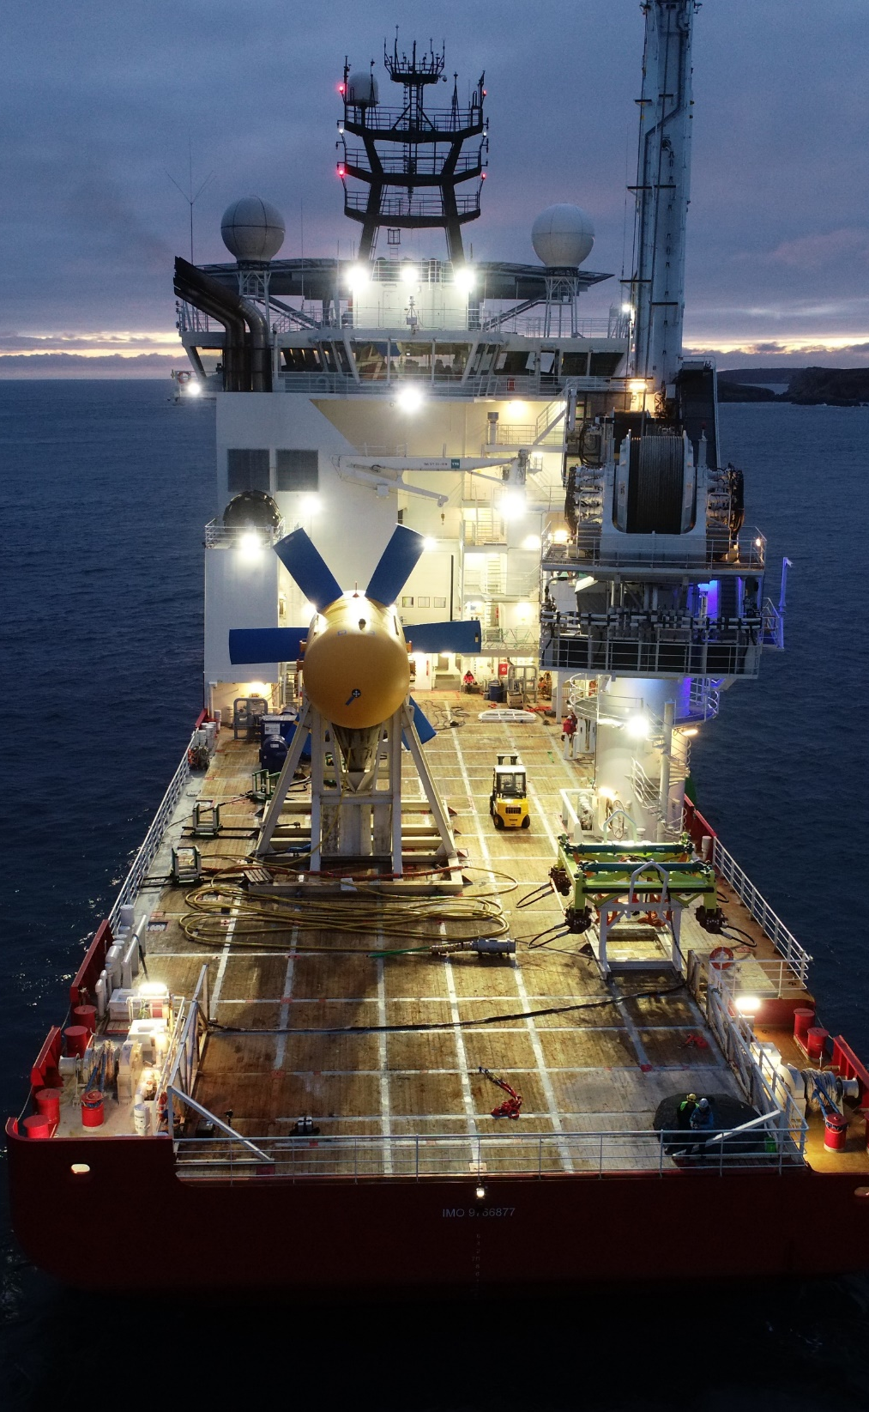

WHERE ARE WE?
Targeting remote and offgrid areas to provide a cleaner and more sustainable energy production.
FRANCE
CANADA
ASEAN
AUSTRALIA
SABELLA

Slide 5
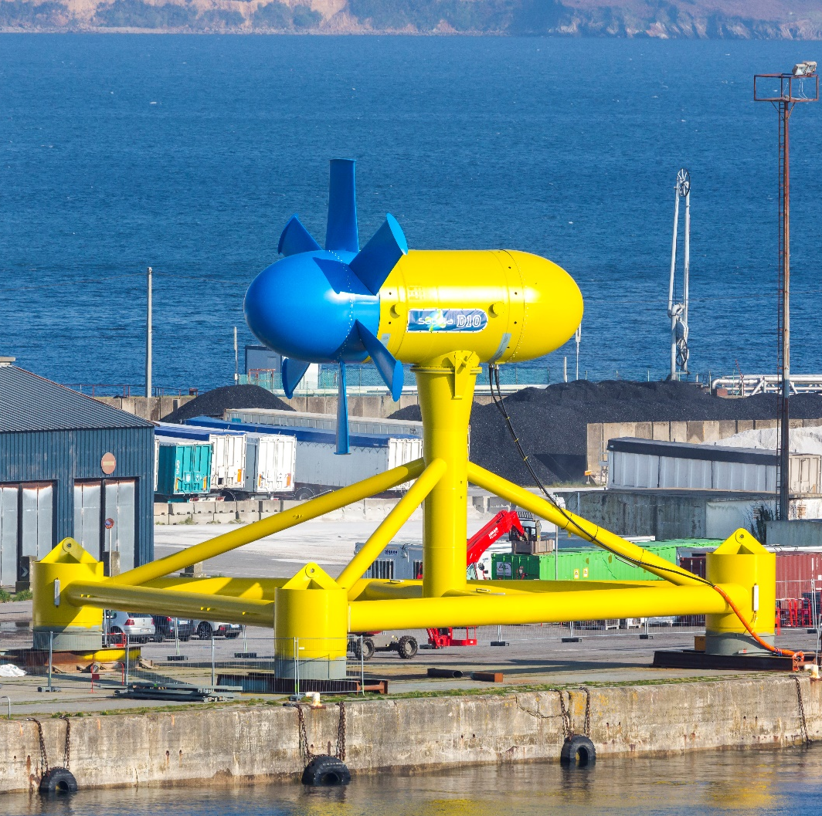
OCEAN ENERGY TECHNOLOGY
Simple – Ruggedized – Reliable
Horizontal axis turbine
Direct drive PMSG
Neither yaw nor pitch drives on the turbine
Seabed mounted: no visual impact, limited use conflict
No drilling, no anchoring
Tried and tested in real ocean conditions with energy supplied to a non-interconnected grid
3-meter up to-20 meter diameter; 25 kW up to 2,000 kW
Electricity exported through an export cable laying on the seabed
TECHNOLOGY

Slide 6
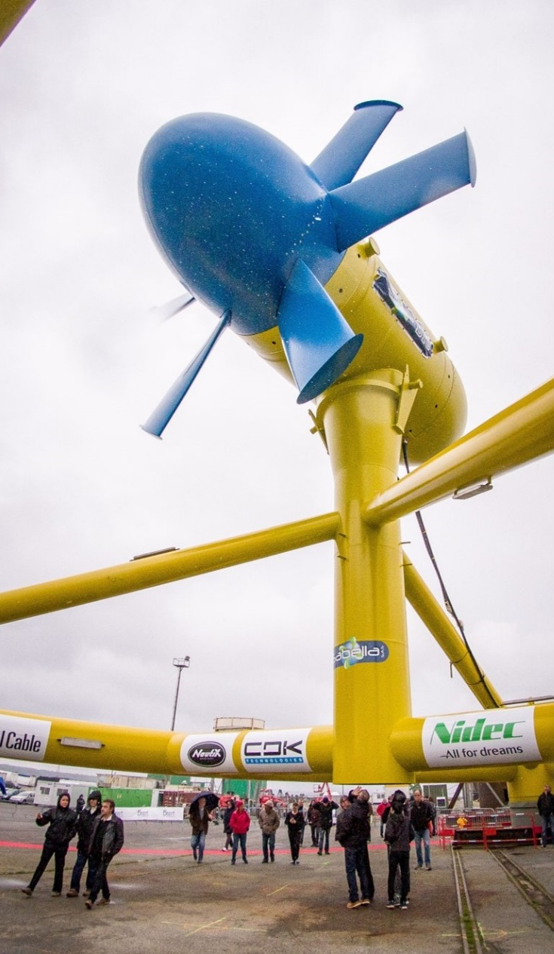
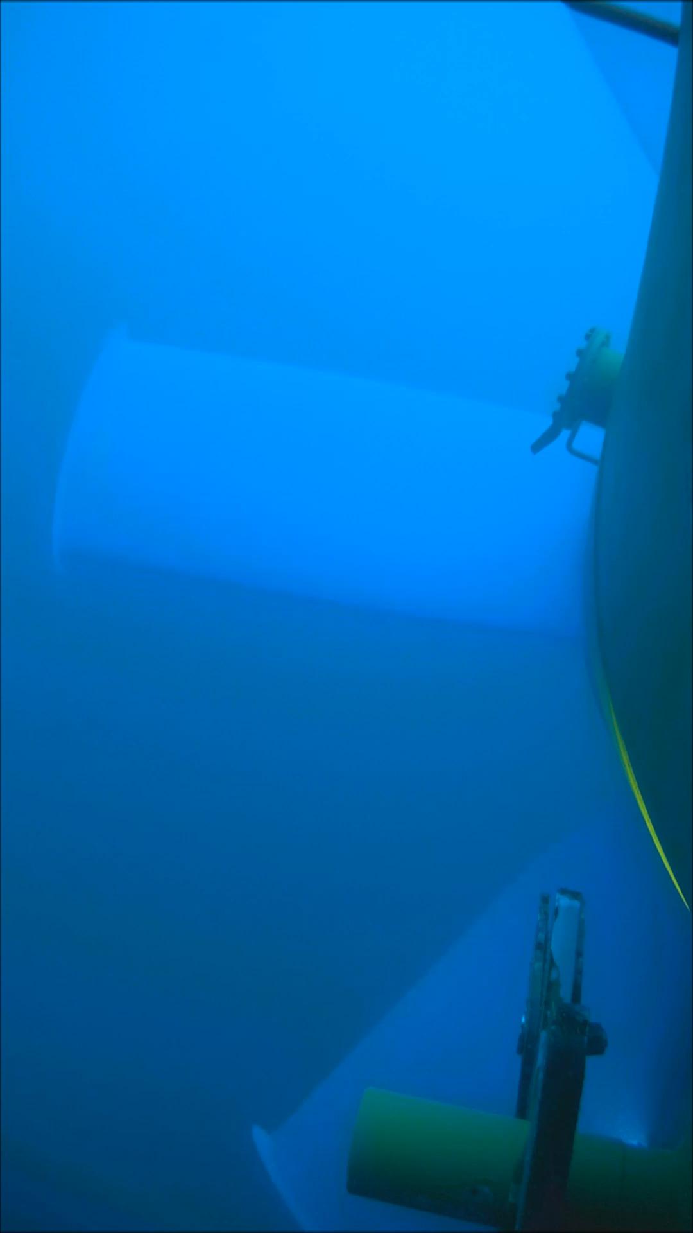
CURRENT STATUS -PROJECTS
1
MW
tidal stream turbine
Injection to Ushant’s offgrid network
1.5
real-condition exploitation at sea
year
D10-1000
installation/retrieval operations
4
Large return on experience
Optimization between first year of immersion and redeployment
PROJECTS

Slide 7
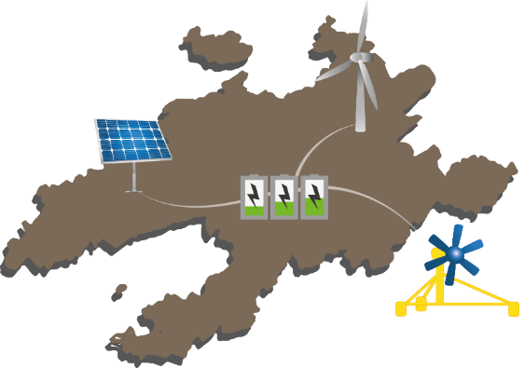
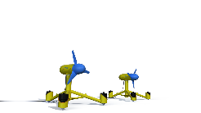


CURRENT STATUS -PROJECTS
Pilot tidal array projects
France – Ushant island: 2 x D12-500
France – Gulf of Morbihan: 2 x D08-250
Canada – Bay of Fundy: 4 x D16-1000
Indonesia – Capul: 2 x D18-1000
PROJECTS

Slide 8

TARGET MARKET & WHY
Focus on remote and offgrid areas
Opportunities to collaborate with both local communities and mining industries
Competitive solution again Diesel gensets to replace fossil fuel consumption by a clean and predictable tidal resource
Easy sizing of onshore Energy Storage System to provide electricity on a 24/7 basis
Perfectly suitable for being coupled with other RE solutions like wind or solar
$6 million per MW installed to provide a sustainable and competitive LCOE
MARKETS

Slide 9
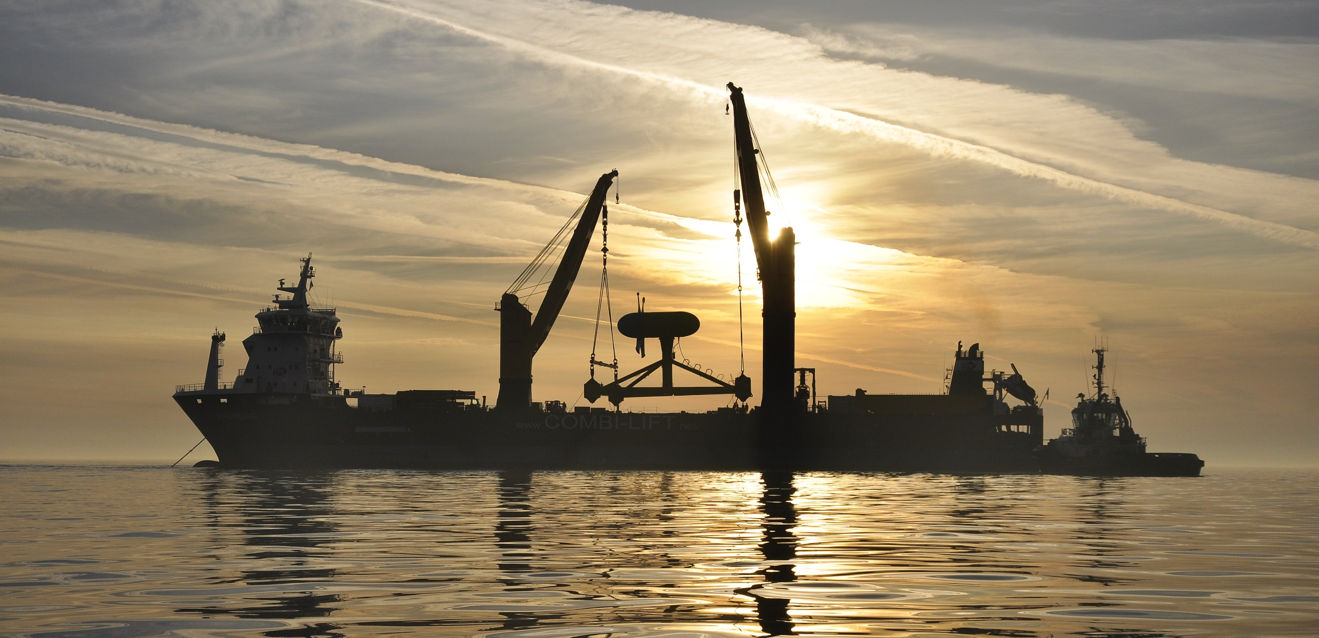
Contact us!
Marlène MOUTEL – Business development engineer
P. +336 761 799 12
E. m.moutel@sabella.bzh
Web: sabella.bzh
oceanenergygroup.org.au

