Slide 1
Desalination Jonathan Fievez, Carnegie Clean Energy

Slide 2
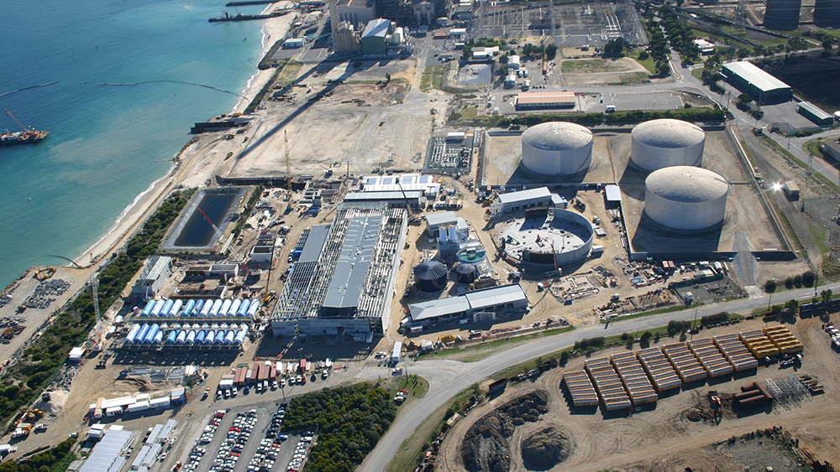
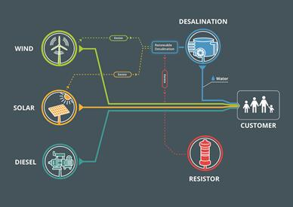
Desalination Sector Status
Desalination continues to grow in contribution to water supply. Currently at 1% globally
48% of Perth’s water and 15% of Sydney’s water from desal
Most of the energy to major systems is from renewables
Reverse osmosis desalination technology is the clear winner
Co-location with energy generation lowers transmission network costs
Many islands use seawater desalination systems

Slide 3
Sector development over time
Factor | Trend
Volume/scale | Growing populations increasing water demand. Rainwater increasingly scarce
Domestic locations | Mainland: Perth, Sydney, Melbourne, Adelaide Island: Rottnest, Kangaroo, Barrow, Christmas, +6
Export locations | Canaries, Bermuda/Bahamas, Indonesian Islands, +many more
Value of energy | High for islands (diesel offset), low for mainland (solar, wind, fossil fuels)
Amount of energy | ~8kWh/m³ (Rottnest = 550 kL/day = 180 kW continuous)
Alternative energy sources available | Solar, wind, fossil fuels
Diversification or consolidation | Unsure

Slide 4
Ocean energy and the desalination sector
Rottnest Island
20 km from the coast of Perth
No electrical connection to the mainland
Energy sources:
600kW solar
600 kW wind turbine
Diesel generators
~ 120 ML drinking water per year
~20 kW/m wave energy resource
Garden Island
1 km from coast of Rockingham/Perth
Bridge connecting so electrical grid and scheme water available
Energy sources:
2 MW solar
SWIS grid
3 x 1 MW diesels (backup)
Desal system can produce ~20 ML per year
~20 kW/m wave energy resource

Slide 5
Ocean energy and the desalination sector - SWOT assessment
Strengths | Weaknesses
Seawater desalination systems are coastal Co-location reduces network charges Co-location allows sharing of: Site data, i.e. bathymetric, geophysical, biological Licenses, i.e. easements, offshore area Can match desalination system demand to ocean energy output Water tanks are equivalent to energy storage but cheaper | Energy from ocean energy isn’t constant Often competing with solar, wind and other sources Difficult to (commercially) pressurise seawater directly from ocean energy devices Islands are usually remote and add to project costs
Opportunities | Threats
Increasing demand for water Increasing need for sustainability in energy sources Diesel price fluctuation problematic for island governments | Downward trend in solar and wind costs Downward trend in energy storage costs

