Slide 1
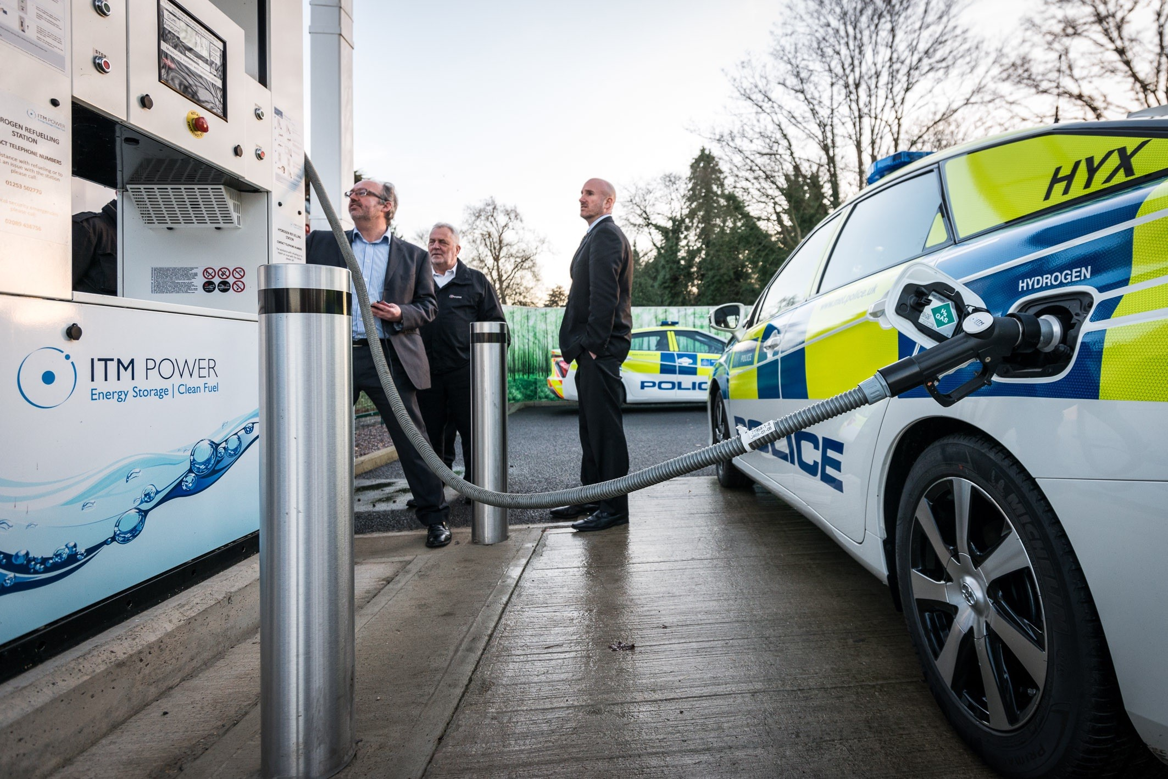
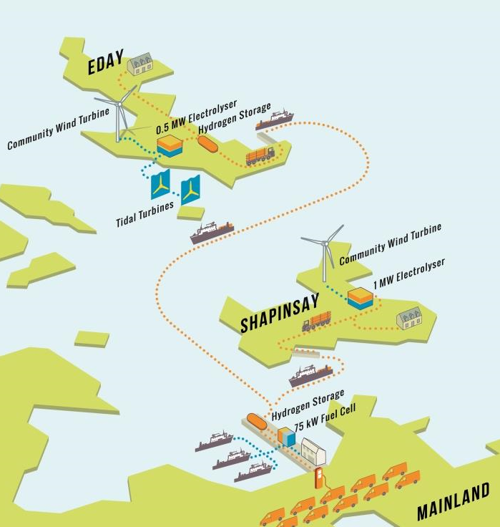

AN INTEGRATED HYDROGEN ENERGY STORAGE SYSTEM IN THE ORKNEY ISLANDS
SYDNEY | 5th DECEMBER, 2019
Hydrogen energy systems

Slide 2
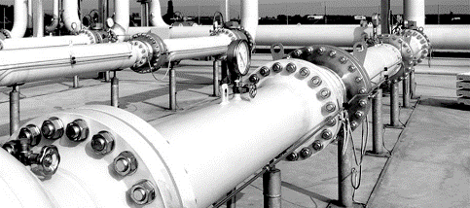
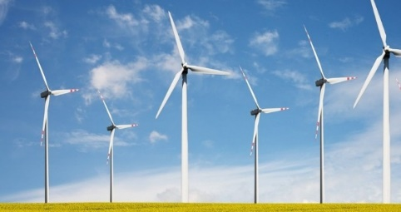
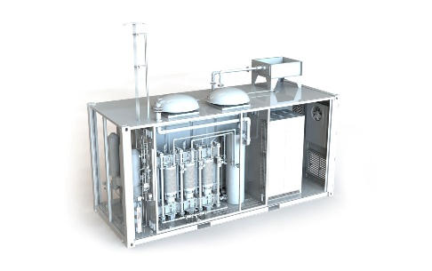


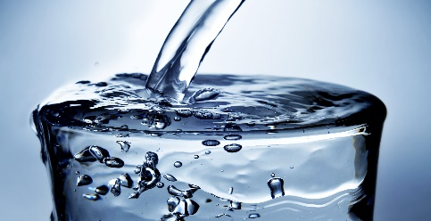
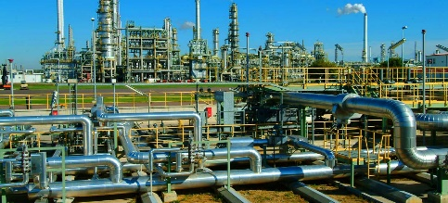
ITM Power | What we do
ITM Power manufactures integrated hydrogen energy systems
Power-To-Gas
Renewable Electricity
Clean Fuel
ITM Electrolyser
Water
Renewable Chemistry
ITM Power | What we do
Hydrogen energy systems

Slide 3
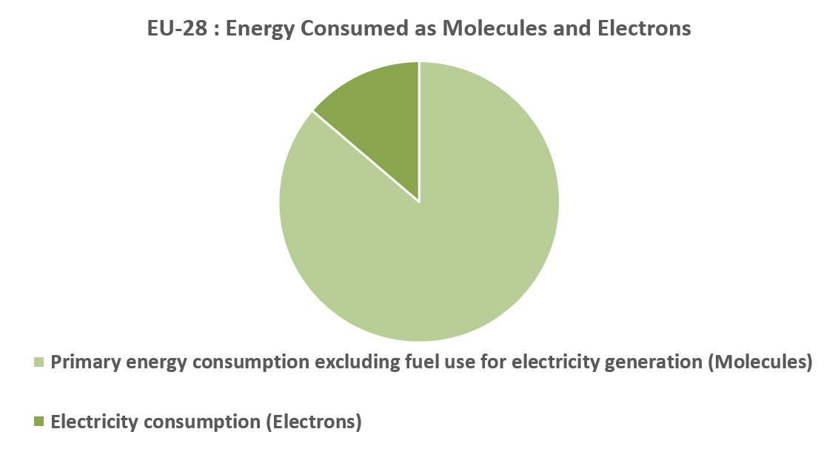
Energy – its not just electricity
We need molecules as well as electrons
Electrolysers convert electrons to H2 Molecules
Renewable molecules based on hydrogen
Extending the sector reach of renewable energy
Source data: DG ENER, June 2017
SECTORAL INTEGRATION
HYDROGEN ENERGY SYSTEMS

Slide 4
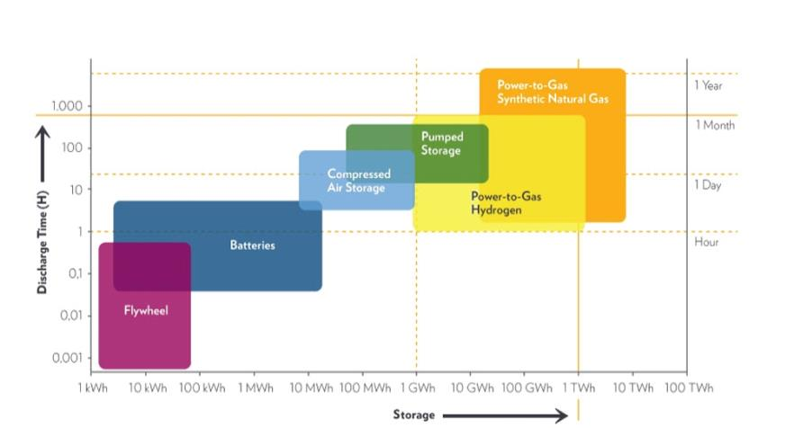
ENERGY Storage technologies
Power-to-gas is efficient | long term | low energy cost
Source: ITM Power plc
Energy storage technologies
HYDROGEN ENERGY SYSTEMS

Slide 5
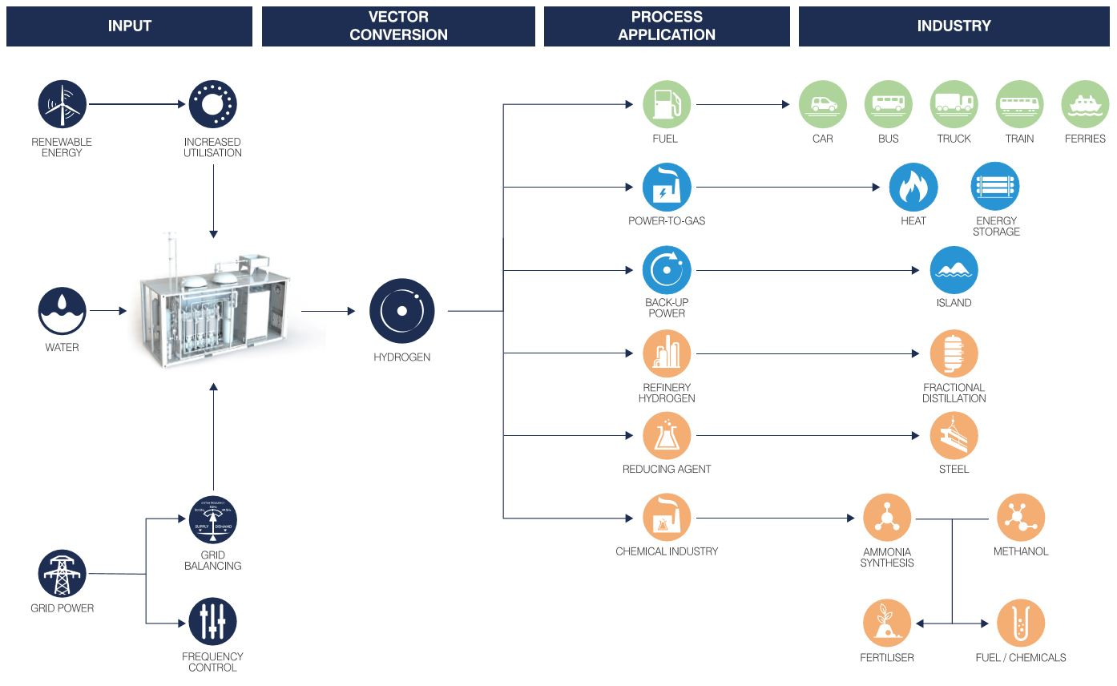
Multiple Sector Applications
Hydrogen energy systems

Slide 6

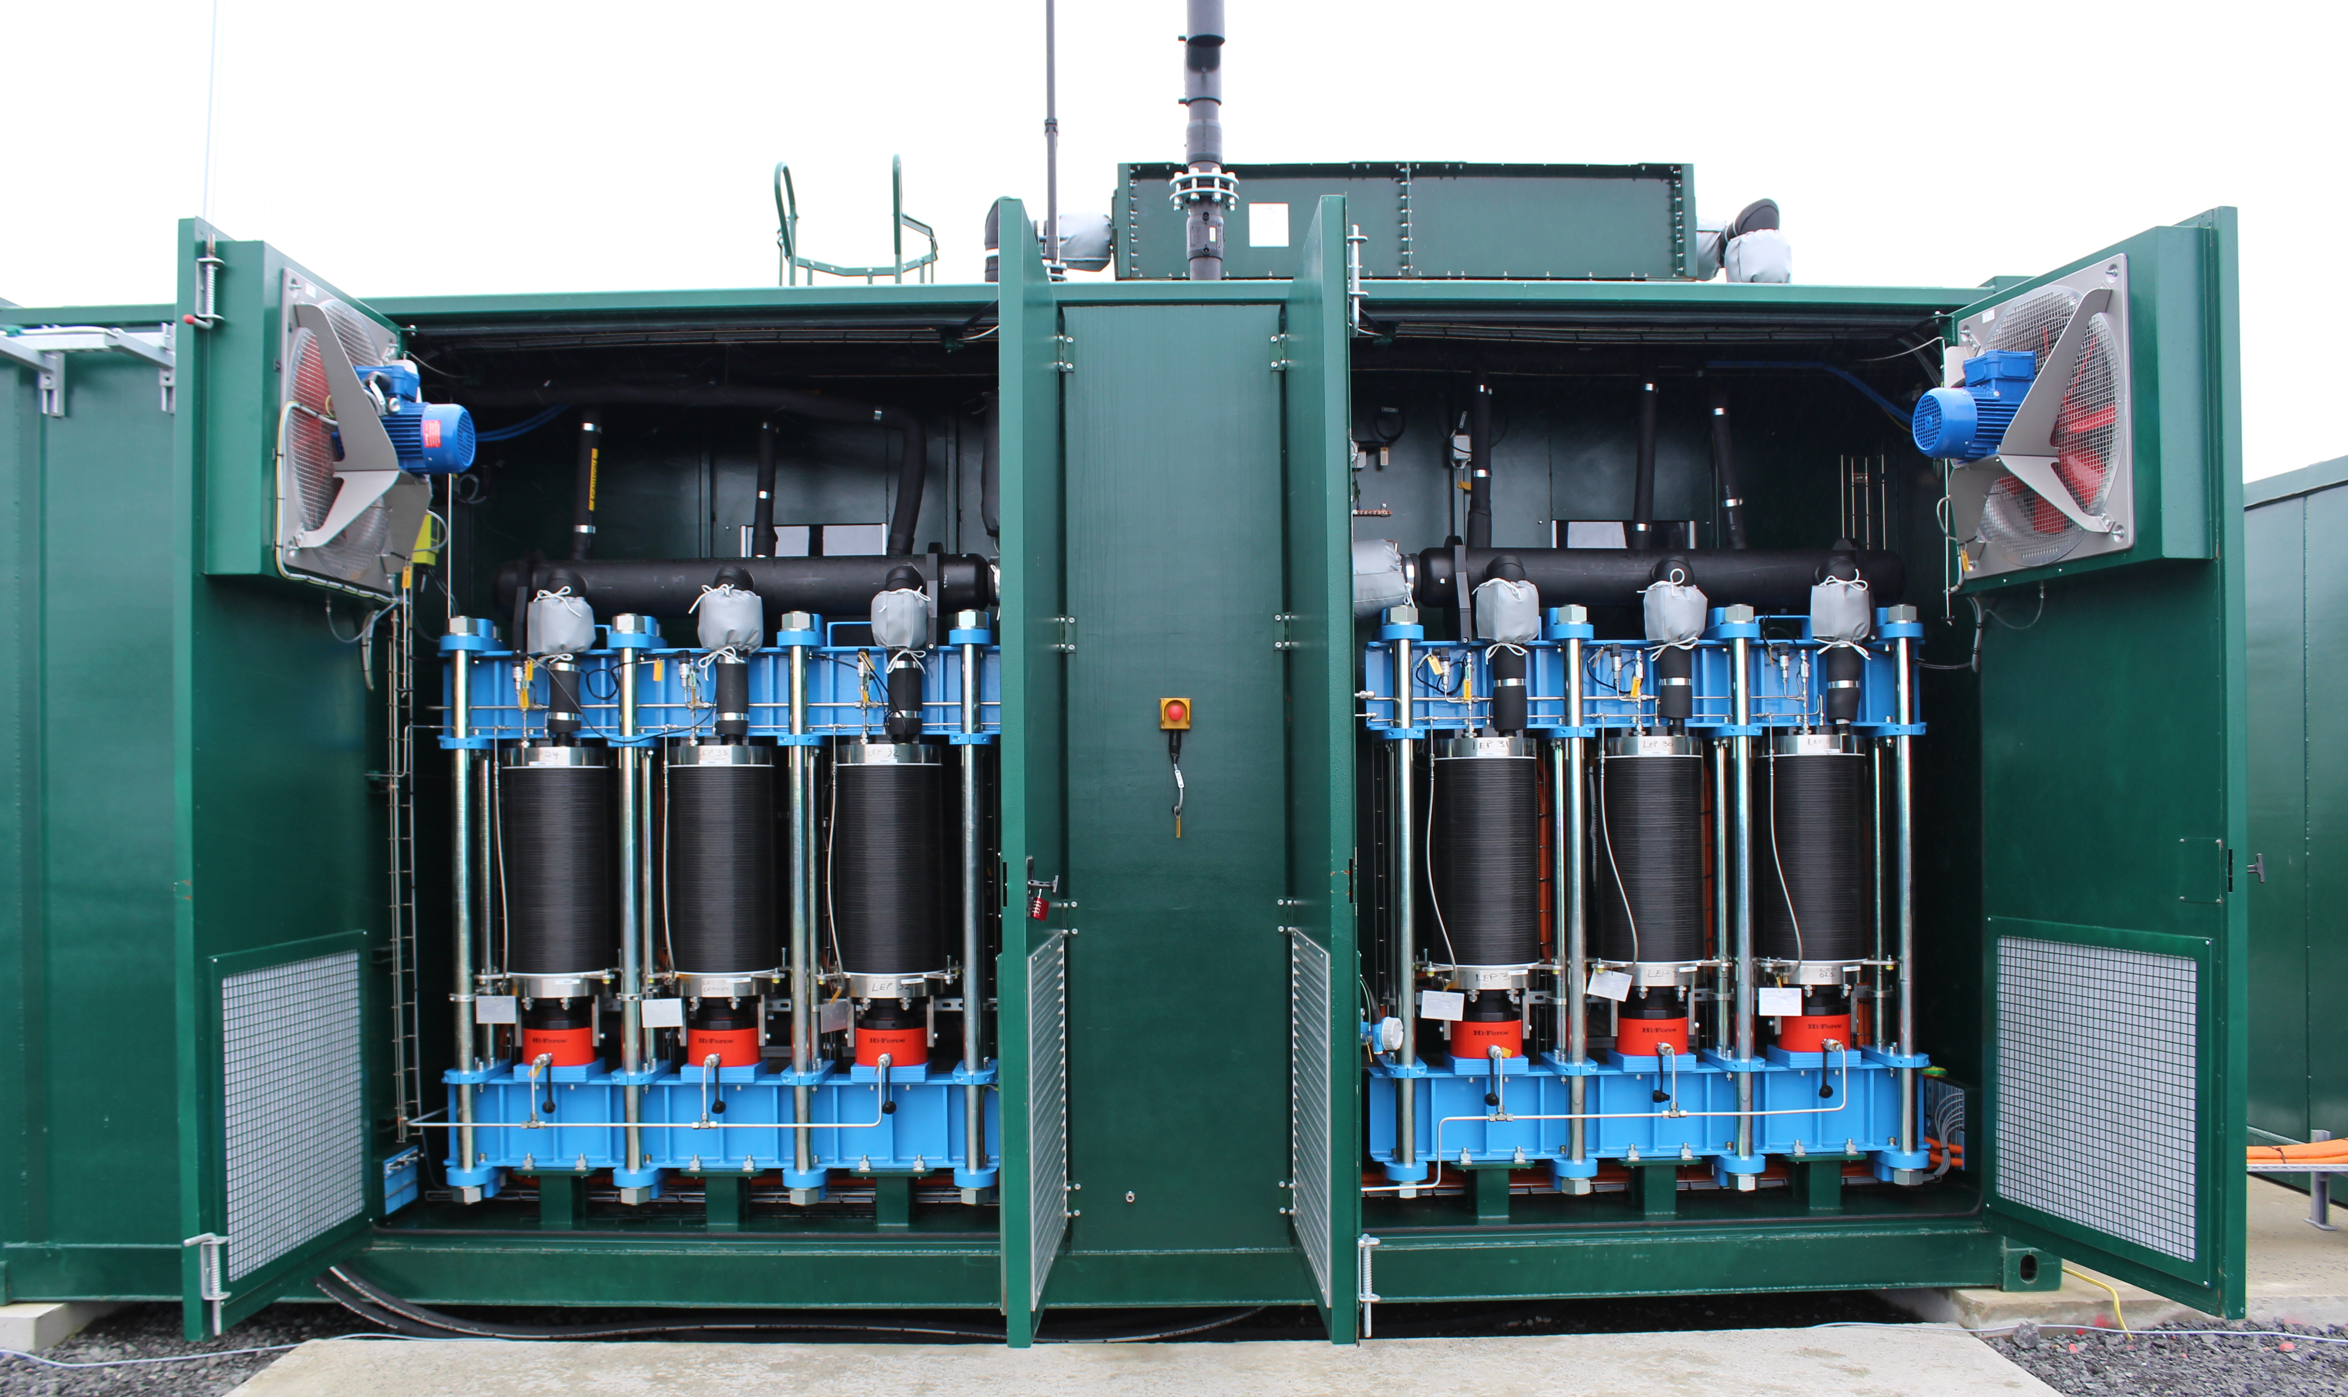
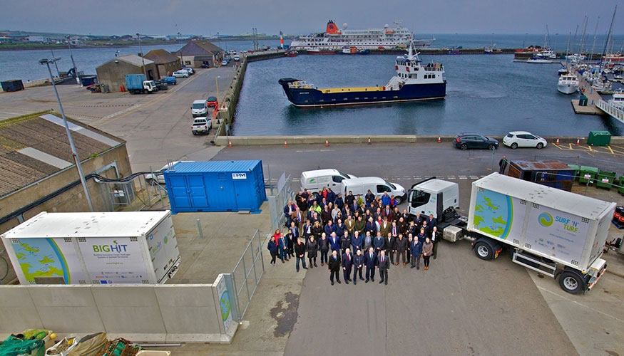

ORKNEY Hydrogen
EMEC | Big Hit | Surf ‘n’ Turf | Dual Ports
Producing hydrogen from stranded wind & tidal renewables
Exporting renewable energy
1.5MW off grid energy storage
Transport, G2P via FC/microturbine and P2G renewable heat
ORKNEY Hydrogen
Hydrogen ENERGY Systems

Slide 7







BiG HiT | ORKNEY
FCH JU Project number: 700092
Eday: Curtailed wind and tidal turbines
0.5 MW of electrolysis | 500kg hydrogen storage
Heating of school
Shapinsay: Curtailed wind
1MW of electrolysis
Heating of school
Orkney Mainland:
75 kW FC: heat and power to marina
H2 refuelling station | 10x Symbio FC vans
Transport: 5x 250 kg tube trailers
ORKNEY Hydrogen
Hydrogen ENERGY Systems

Slide 8

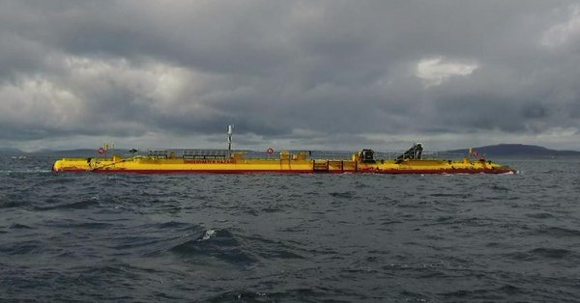
Lessons to date | ORKNEY
WAVE TURBINES
2MW peak base load station
3GWh of renewable energy supplied in first year
Supplies around 25% of Orkney Islands base load
Balance converted to hydrogen for shipping to mainland
Grid stability maintained via PEM electrolyser
Net benefit of GBP 1.4b and 4000 jobs by 2030
ORKNEY Hydrogen
Hydrogen ENERGY Systems

Slide 9
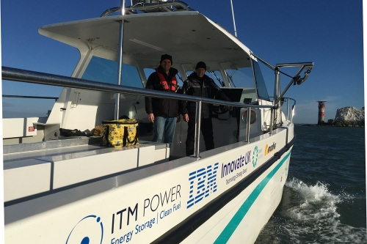

Lessons to date | ORKNEY (cont’d)
MARINE HYDROGEN
Project started with direct injection hydrogen marine engine
Fuel cell powered car ferry as next step
EU funds committed at over E12m
Boost to Scottish ship building industry
Partnership with Ballard fuel cells
Export of marine hydrogen IP via University of St Andrews
Will require increased renewables and hydrogen volumes
ORKNEY Hydrogen
Hydrogen ENERGY Systems

Slide 10
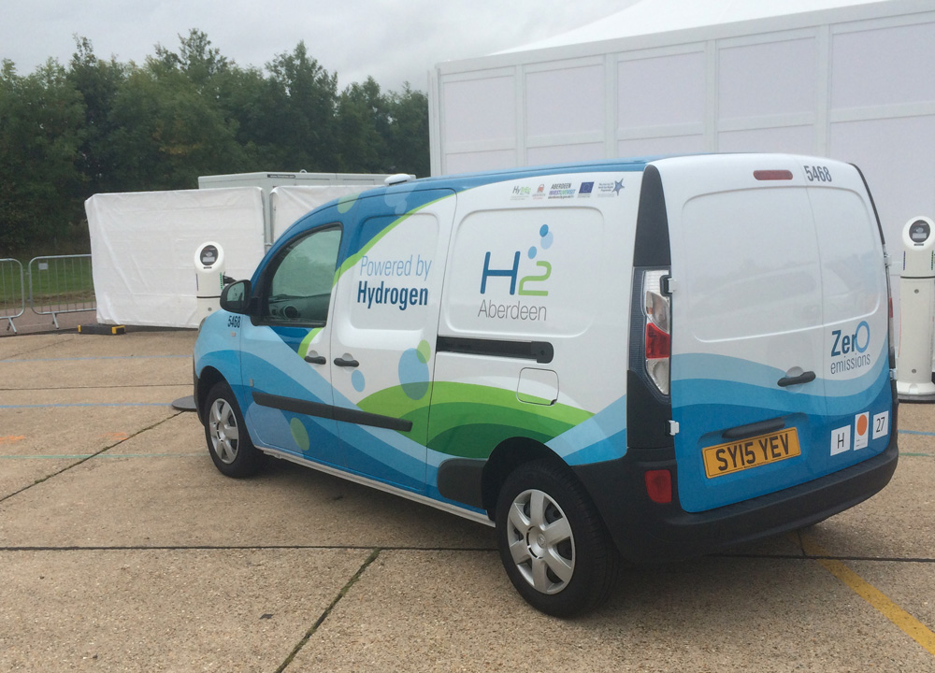
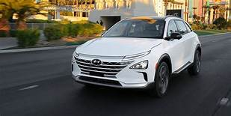
Lessons to date | ORKNEY (cont’d)
VEHICLE HYDROGEN
Project started with retrofit fuel cell vans
OEM fuel cell powered cars as next step
Boost to Scottish aftermarket vehicle industry
Leveraging lessons from Shell retail refueller outlets
Will require increased renewables and hydrogen volumes
ORKNEY Hydrogen
Hydrogen ENERGY Systems

Slide 11
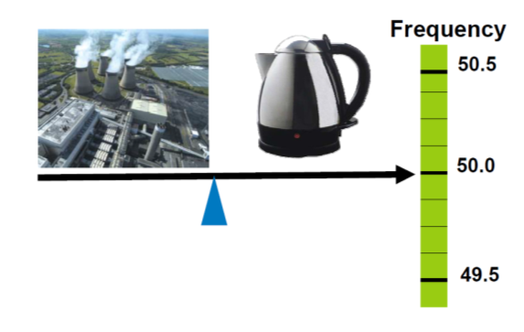
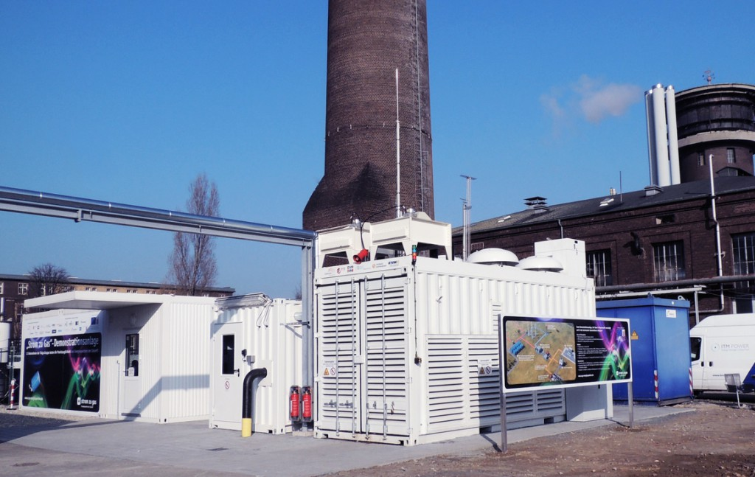
Balancing ISLAND GRID / RENEWABLES Supply & demand:
Second by Second
Dynamic
Rising Frequency
Falling Frequency
Supply Side Balancing Action
Turn OFF a generator
Turn ON a generator
Demand Side Balancing Action
Turn ON a load
Turn OFF a load
Grid balancing for intermittent renewables
HYDROGEN ENERGY SYSTEMS

Slide 12
FUTURE SCOPE | size
Energy Storage | Grid Balancing
Enhanced Frequency Response needed as renewables grow to 40MW or 100% on the islands
10MW rapid response electrolyser | 50% operating point
Turn Up & Down by 5MW simultaneously
Sub-second response
10MW rapid response electrolyser | 50% operating point
5MW Turn Up
5MW Operating Point
5MW Turn Down
Grid balancing for intermittent renewables
HYDROGEN ENERGY SYSTEMS

Slide 13
WHY Power-to-Gas FOR ISLAND?
Electricity cannot be stored easily | Hydrogen can be stored easily in the local gas grid
Two smart grids enabled by P2G
Smart use of gas grid by electricity grid
Mutually supportive
Decarbonise both
Source: ITM Power pl
Power-to-gas rationale
Hydrogen energy systems

Slide 14
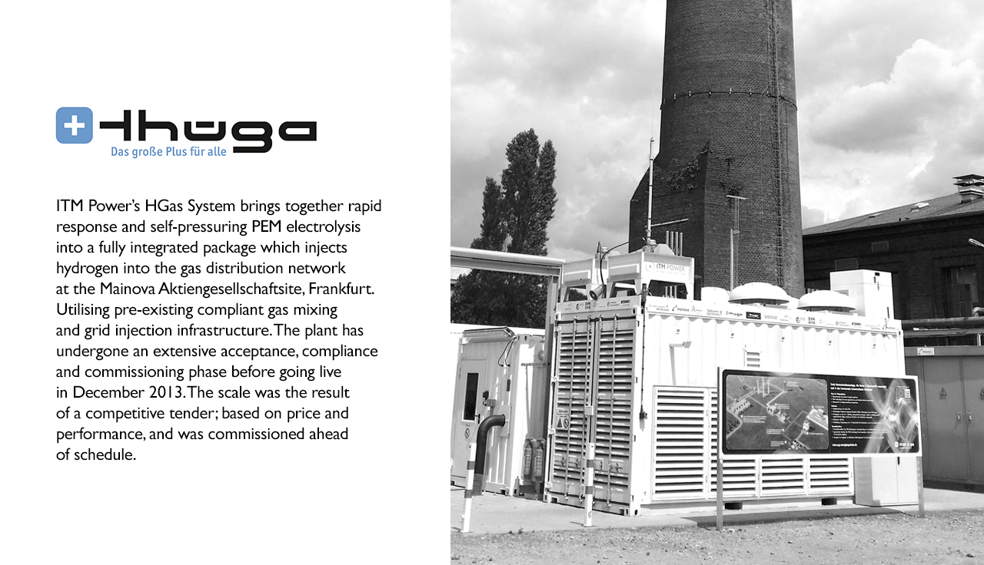

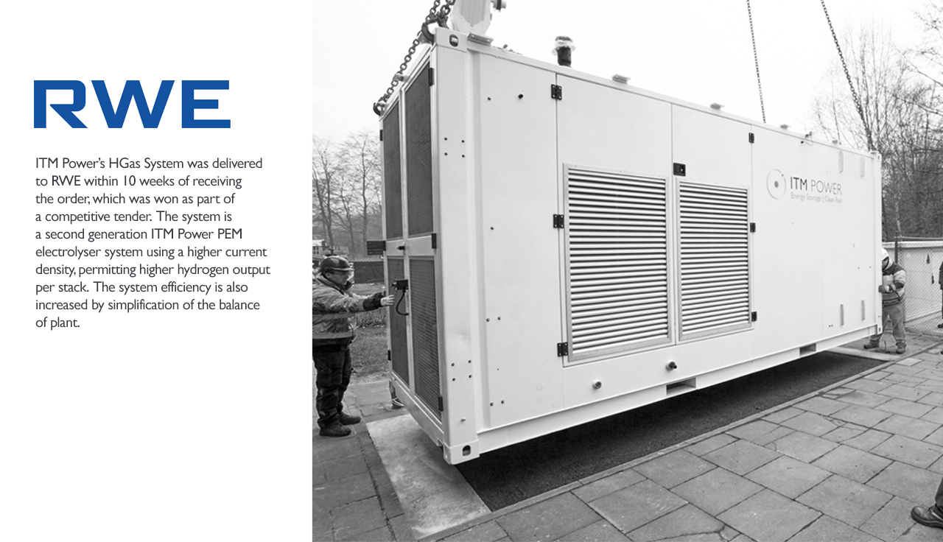
LEVERAGED ITM P2G EXPERIENCE
German Utility | Performance Evaluation
Thüga group:
  2013 First PEM electrolyser in Power to Gas
  Operated in grid-balancing market
  Successfully tested for primary balancing market
  77% electrical system efficiency
RWE / Westnetz
  Second generation system
  Utilises waste heat
  86% efficiency with heat recovery
Source: ITM Power GmbH
Power-to-gas
Hydrogen energy systems

Slide 15
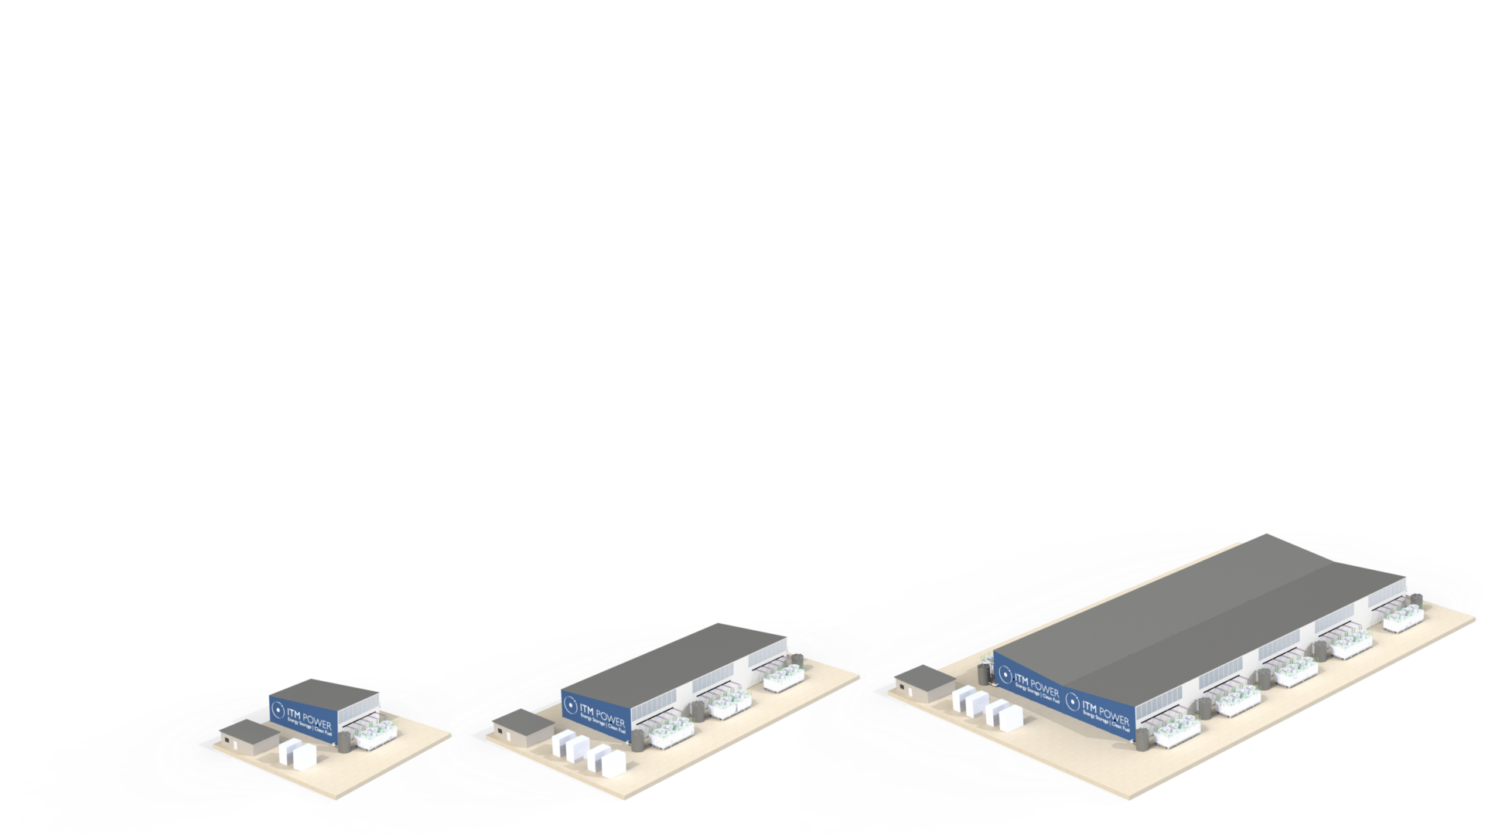
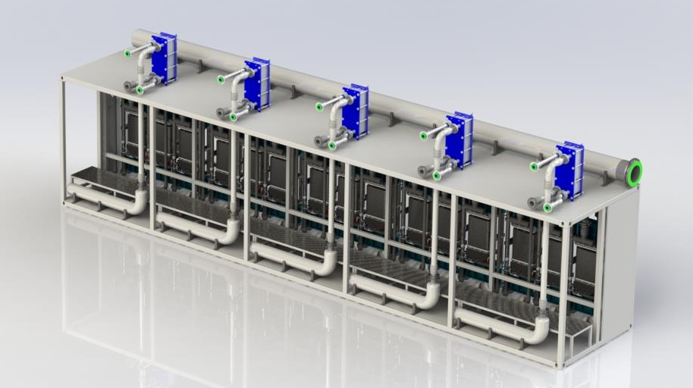
Systems at Scale
100MW based on 10MW stack skid
10MW containerised stack skid
Individual control of each 2MW module
Waste heat recovery option
Integrated ventilation strategy
Energy density of >8,000kWhr/m² (when run for 24 hrs)
* Examples illustrated to demonstrate principle of replication
4T /day
10MW
4T /day
10MW
25x25m
20T /day
50MW
25x125m
40T /day
100MW
20x150m
Systems at scale
Hydrogen energy systems

Slide 16
An integrated Hydrogen ENERGY STORAGE SYSTEM in the orkney islands
Ocean energy market development summit | 5th December, 2019
Summary
Renewables need Energy Storage
Electrons make up a small percentage of energy use at around 20% | molecules are dominant
Rapid Response Grid Balancing electrolysers- needed at the right scale to match intermittent renewable inputs
Low cost | Low footprint | Mature Technology
Power to Gas provides long-term energy storage and provides a proven route to deep decarbonisation of gas
The gas grid – is a useful asset in managing surpluses and deficits in a low carbon power system
Gas to power available via fuel cell & microturbines with use of waste heat for cooling via absorption chillers
Onsite Electrolysers offer synergy in the expansion of renewables & hydrogen mobility on land and sea
Fuel cell transport – no compromise, enables rapid adoption for clean emission cities and oceans
Intersection of renewables with existing electricity and gas networks is the key to LCOE reduction and ZEV adoption
Hydrogen energy systems

Slide 17
AN INTEGRATED HYDROGEN ENERGY STORAGE SYSTEM IN THE ORKNEY ISLANDS
SYDNEY | 5th DECEMBER, 2019
Hydrogen energy systems

